Slide 1
Part 6 Static Files & HTTP
Version: 4.0.1
Written and design by: Babar ali

Slide 2
What is Static Files?
Websites generally need to serve additional files such as images, JavaScript, or CSS. In Django, we refer to these files as “static files”. Django provides django.contrib.staticfiles to help you manage them.
Static Files
Images Files
CSS Files
JavaScirpt Files

Slide 3
How to add static files in Django project?
Step No 1
Create a Folder in your Django project name as “static”
Step No 2
Copy all the files like images, js, plugins, styles and paste in your static folder
Step No 3
Go to “settings.py” and write the following code:

Slide 4
Static files continue…
Settings.py
STATICFILES_DIRS = [
os.path.join(BASE_DIR, 'static')
]
STATIC_ROOT = os.path.join(BASE_DIR, 'assets')
Step No 4
Write the following command:
>>> python manage.py collectstatic

Slide 5
How to use static files in HTML page?
Go to your web page and write in the first line “{% load static %}”.
Then change your links with the given below method.
my_site/template/home.html
{% load static %}
<head>
<title>Document</title>
<link href="{% static 'my_style.css' %}">
<link href="{% static 'frame.js' %}">
</head>

Slide 6
How to add two numbers using Django?
To add two number first of all:
create a function to view the input filed for user.
Then create a second function to create calculation.
Create two HTML file for function 1 and function 2.
Then create a URL for both function.

Slide 7
Create Function For Addition
First of you must create URL for your IP’s to access the function.
my_site/first_app/urls.py
from django.http import HttpResponse
from django.shortcuts import render
# Create your views here.
def home_page(request):
return render(request, 'home.html')
def add_number(request):
num1 = request.GET['num1']
num2 = request.GET['num2']
add = int(num1) + int(num2)
print(add)
return render(request, 'add_num.html', {'answer': add})
The “name1” & “name2” is the input filed name to get the data.

Slide 8
Create URL For Addition
First of you must create URL for your IP’s to access the function.
my_site/first_app/urls.py
from django.urls import path
from . import views
urlpatterns = [
path('',views.home_page),
path('add_number/', views.add_number)
]
Import the “views” file function with the help of “from” keyword
Function name used to access the Django function.

Slide 9
Create HTML file For Addition
First of you must create URL for your IP’s to access the function.
If you click the submit Button the “add_number” function is called
my_site/first_app/urls.py
<form action="add_number/">
<h3> Enter First Number : </h3>
<input type="number" placeholder="Enter First Number" name="num1">
<h3> Enter First Number : </h3>
<input type="number" placeholder="Enter First Number" name="num2">
<br> <br>
<input type="submit" value="Add Numbers">
</form>
The name attribute is used to get the data of input field

Slide 10
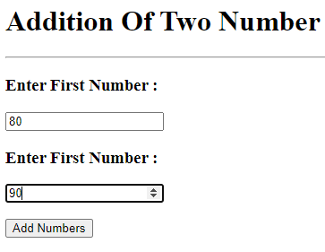
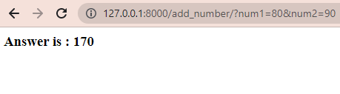
The Result is Looks Like This
You can see the URL the add function is called and get the values of “num1” and “num2”.
Click the “Add Number” to see the result

Slide 11
What is HTTP?
The Hypertext transfer protocol (HTTP) is designed to enable communication between clients and servers. HTTP works as a request-response protocol between a client and server.
Example:
A client (browser) sends an HTTP request to the server then the server returns a response to the client.

Slide 12
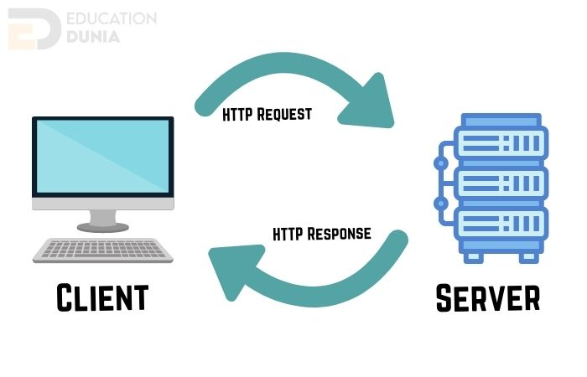
How HTTP works?
The following diagram show how the HTTP works in website development

Slide 13
What is Tag in Django?
Tags provide arbitrary logic in the rendering process.
This definition is deliberately vague. For example, a tag can output content, serve as a control structure e.g. an “if” statement or a “for” loop, grab content from a database, or even enable access to other template tags.
Tags are surrounded by {% and %} like this:
{% csrf_token %}
{% if user.is_authenticated %}Hello, {{ user.username }}.{% endif %}

Slide 14
Template inheritance using Jinja Format
“Template inheritance allows you to build a base “skeleton” template that contains all the common elements of your site and defines blocks that child templates can override.”
The {% block content %} acts as a placeholder for whatever components we want to display between header and footer.
The {% extends “base.html” %} inherits everything from the base template. Code between the {% block %} tags above is placed inside {% block %} tag in the base html, so when Django processes the template, this is how the home page is rendered:

Slide 15
Example
Basic.html
Home.html
Menu Bar
{% extends ‘basic.html’ %}
{% block content %}
Home page coding
{% endblock %}
{% block content %}
HTML Coding
{% endblock %}
Footer

Slide 16
Template inheritance
When you want to add a page using jinja format used
{% include ‘template_name’ %} :
{% include ‘navbar.html’ %}
{% include ‘contact.html’ %}
{% include ‘about.html’ %}

Slide 17
Example
Basic.html
About.html
{% extends ‘basic.html’ %}
{% block content %}
{% include ‘about.html’ %}
{% include ‘contact.html’ %}
page coding
{% endblock %}
Home.html
Contact.html

Slide 18
Django Jinja Format
Base.html
Home.html
<body bgcolor = “blue”>
{% block content %}
(code is here)
{% endblock %}
</body>
{% extends ‘base.html’ %}
{% block content %}
{% include ‘header.html’ %}
<h1> Hello World </h1>
{% endblock %}
The “base.html” style is used home.html page.

Slide 19
Thanks for Reading

